Slide 1
API Exploration

Slide 2
Purpose
API’s (Application Programming Interface) enable easy machine access and use of information through the internet.
I explored the API’s for Transport for London and theMovieDB.com.

Slide 3
Initial Questions
Transport for London:
Can I find information about all supported transport methods?
Can I find information about stops, lines or routes?
Can I plan a journey?
theMovieDB:
Can I find and collect information for movies, tv show and actors?
Tools:
Jupyter notebook with json, requests and os imported.

Slide 4
Supported Transport Methods
Initial Strategy: Make a request asking for all the types of lines or stops.
Findings: Meta category of requests
Provides valid input information for other requests.
URL request: https://api.tfl.gov.uk/Line/Meta/Modes?app_id=[app_id]&app_key=[app_key]
Found 18 types of supported transport methods
Notes:
From initial exploration, baseline methods would work. Finding the Meta category helps with exploring the rest of the api. These are request that provide information about other requests.
URL root and url keys shown here for completion sake. Area of interest for the request is in red.

Slide 5
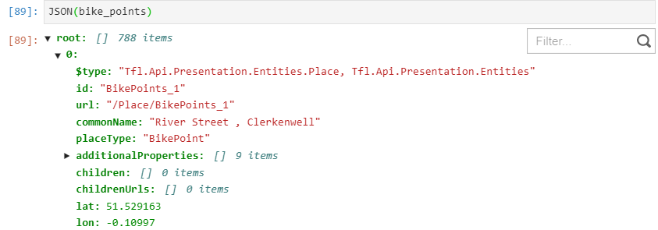
Information about stops
Stops were examined for BikePoints.
Request info: /Bikepoint
Use JSON() function to easily access and examine database.
Notes:
JSON provides a dictionary that can easily be accessed with python functions. Using this we found that there were 788 BikePoints, with 20914 docks of which 459 were broken.

Slide 6
Information about lines
Can we filter for only specific types of transport?
Request Info: /Line/Mode/tube,bus
Meta call from earlier was used to provide the [tube, bus] request info.
689 tube and bus lines, with 11 being tube lines.
Stops on a line?
Request Info: /Line/Victoria/Route/Sequence/Inbound
Provided the stations in order along the route.
Notes:
We were able to access some information about all stops in london, and a specific feature of each. What about lines?

Slide 7
Can we plan a journey?
Most complex request found in API exploration.
Request URL: /Journey/JourneyResults/{start}/to/{end}
Contains many tunable parameters not limited to:
Modes of travel
Time and date of travel
Time limits for walking and transfer waits
Travel via specific locations
Notes:
Start/end can be locations, GPS coordinates, stopPoints.

Slide 8
Scenario: Heathrow to London Bridge
Test 1: start = Heathrow, end = London Bridge
Status Code : 300 – Disambiguation
Provides a list of entries that the program could not be distinguished been.
Test 2: start = Hillingdon, Heathrow Airport Terminal 2, end = City of London, Tower Bridge
Status Code : 200 Success
Notes:
I decided to test the call with a hypothetical grad journey to London bridge.
Disambiguation means no unique entries were made for either start or end. The app couldn’t distinguish between multiple locations in the network. Made a list with all diambiguation names, and then could select which one I desired.
This provided 3 journey options leaving immediately and using any method to travel.

Slide 9
Heathrow to London Birdge (cont.)
Date/time parameters?
Use same journey url as before.
Add parameter request: ?timeis=departing&time=1200&date=20210401&
Departure time for journey is now 04/01/2021 and up to 15 minutes before 12:00.
Mode parameters?
Parameter: mode=bus&
Journey only uses walking and bus transportation.
Notes:
Can we select time and date parameters for our journey? Afterall, I can’t make it to London until after the bootcamp is finished. Noon April 4 was selected for the next test. I used this time and date parameter as the start for all other requests.

Slide 10
Further requests
Walking minimized (max 30 minutes walking)
Parameter: journeyPreference=LeastWalking&maxWalkingMinutes=30&walkingSpeed=slow&
Provides a route with walking minimized between stations.
Shortest journey in time:
Parameter: journeyPreference=LeastTime&
Notes:
My Wife hates walking, can we get the fastest journey with minimal walking?

Slide 11
Journey summaries
Journey length using only buses : 203 minutes
Journey Length using only tube : 84 minutes
Journey Length using tube or bus : 87 minutes*
Journey Length with least time: 76 minutes
Journey Length with minimal walking: 93 minutes
Notes:
Tube or bus is longer because it prefers to wait at the station for a bus rather than walking to the final destination. Shortest journey uses national rail line. Walking min goes to a different station that has a direct transfer to a bus line rather than walking between lines.

Slide 12
MovieDB exploration
Initial exploration using:
Request: search/movie?query=[movie]
Provides basic information and id.
Search for more detailed information:
Request: /movie/[movie_id]
Provides advanced information such as revenue and cost.
Similar functions for tv and person.

Slide 13
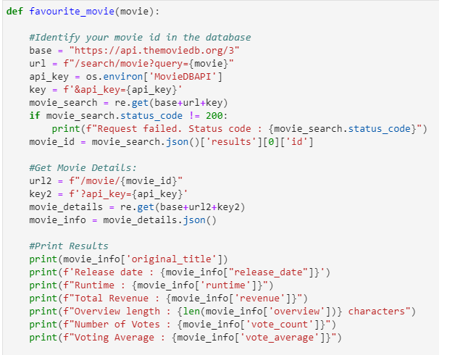
Making a Function
Sample code below:
Notes:
Similarities in the request made the code very easy to generalize for each category. A trending function was also made. Trending call was /trending/{media}/week. Included fail request if an invalid entry was made.

Slide 14
Conclusions
Each step built on the steps before it, culminating in a simple function for the movie database.
Trouble points were:
GPS coordinates in journey request – Ensure that entered as a string with sufficient decimal places.
Developing a method to easily modify parameters.

